Slide 1
Marketing & AI
Assaf Lowengart, Kayla Calvin, Emily Deuell
Team Nine

Slide 2


Slide 3
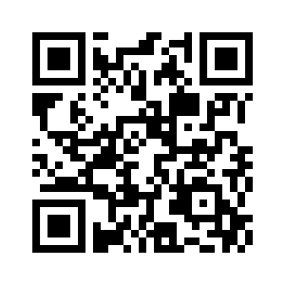
Please follow this link: pollev.com/emilydeuell975
OR use the QR Code

Slide 4
Agenda
What's next in AI & Marketing? How can we, as data scientists, get involved? (KC)
Problem Statement
What does Artificial Intelligence in Marketing look like? (KC)
Current Research
What's currently being done in the field? (KC)
Coding Demo
How is AI implemented? (ED)
How does this translate to businesses? (ED)
Launch
Ethics

Slide 5
Problem Statement
Artificial Intelligence is being used in Marketing in several different ways to enhance customer's experience and operational efficiency. Some uses include personalized ad targeting and content creation. We want to explore how these ideas can be implemented for businesses to better serve their customers and the ethics behind the two fields combined.

Slide 6
Current Research
Seen as an overall positive addition
AI is being implemented in all aspects of Marketing
Helping with more personalized experience for customers
Ad-targeting
Profound hunting
Shorten time spent on collecting/processing data
More dynamic marketing
Content creation
Better forecasting models
Keeps the data up to date
Models are continuing to learn
Notes:
Current Research slides:
Throughout our research there is a overall feeling that AI in marketing is something positive
Its not just in one area but is used in all different aspects of Marketing
One way is the great a more customized experience to customers This is used in
Enhanced ad- Targeting
Programmatic advertisements
Developed using customer behavior analyses
Cookie data is gathered to make informative decisions using it for real-time campaign optimization
Ads viewed by customer depends on their past searches and actions
Profound hunting
Help marketers analyzing customer search patterns
Another reason that AI is being used is to shorten the amount of time marketers spend on collecting and processing data
This makes marketing more dynamic
One way that this process is faster is the use of content creation systems that can be used in creating emails to customer
Since data is being collected faster this creates more accurate forecasting models
Models are able to have data that is up to date as well as able to keep learning as new data is added

Slide 7
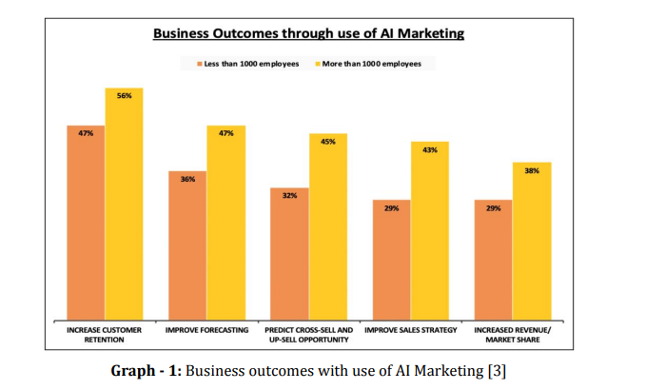
CURRENT Research
Notes:
This graph is to shows results achieved through the implementation of AI Marketing.

Slide 8
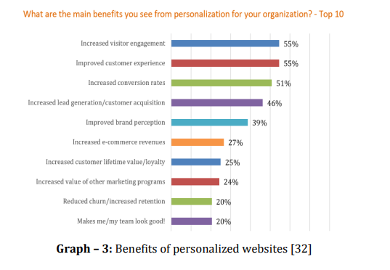
Current research

Slide 9
And Now for the example...
With your host Emily Deuell

Slide 10
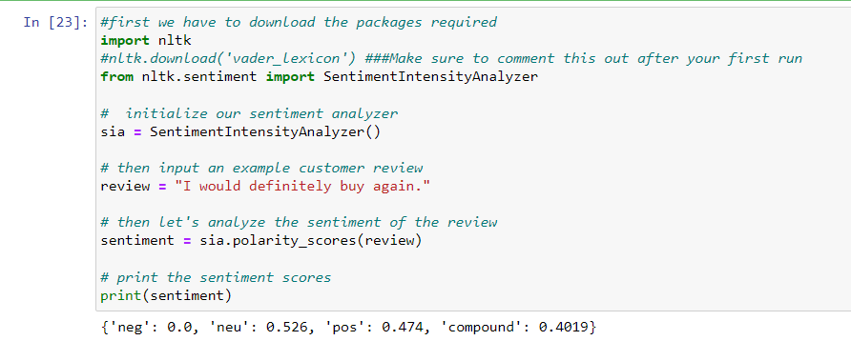

Slide 11
ETHICS
Ethical concerns are already an issue for marketing and artificial intelligence. It’s only increased when you marry the two.

Slide 12
Ethical Concerns
TRANSPARENCY
PRIVACY CONCERNS
JUSTICE & FAIRNESS
A lack of transparency (or explainability) around AI, especially when it comes to marketing, is harmful to the consumer.
When tailoring algorithms to a consumer, there is concern of how much data is being acquired (i.e., tiktok) and what will be done with the information acquired.
There is fear over what parties could be taken advantage of through AI in marketing, as well as, how information can be biased depending on the sphere in which it is gathered.

Slide 13
What's Next?
AI is reshaping traditional marketing strategies
Still in it's infant stages
Growing rapidly
Ways companies are using AI:
Starbucks
Personalized messaging and recommendation on mobile app
Nike
Customizing shoes
Amazon
Physical stores using AI- powered sensors and detect what customers have picked up

Slide 14
SUMMARY
AI & Marketing are becoming increasingly integrated fields. Artificial Intelligence can help tailor marketing campaigns to consumers and gage public opinion on products/services.

Slide 15
Poll EV
Another One:

Slide 16

Lastly...

Slide 17
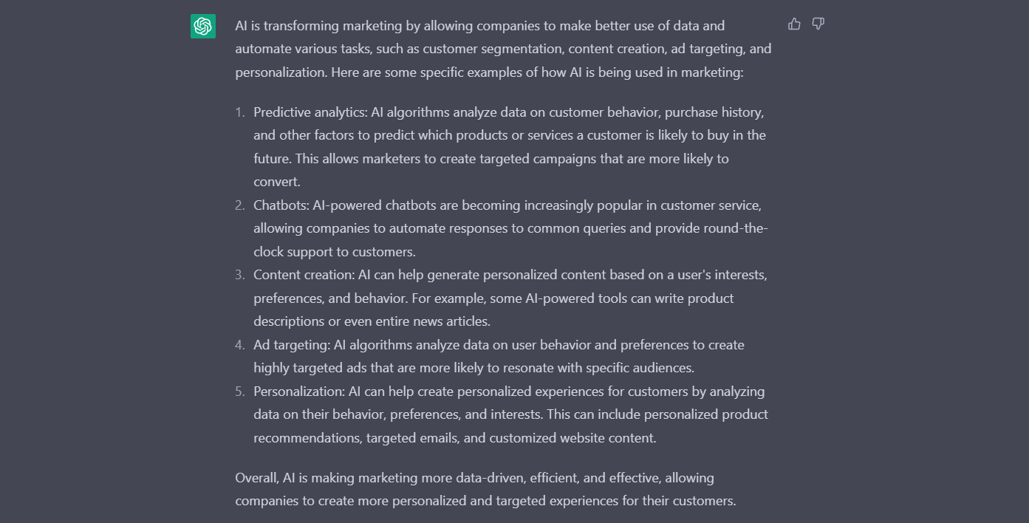
Chat GPT SAYS...

Slide 18
Resources
Su, Y., Wang, E. (J., & Berthon, P. (2023). Scholarspace. Home. Retrieved April 17, 2023, from https://scholarspace.manoa.hawaii.edu/
Admin. (2023, March 13). Artificial Intelligence in Marketing Ethics: Striking the right balance. InnovareAI. Retrieved April 17, 2023, from https://innovareai.com/artificial-intelligence-in-marketing-ethics-striking-the-right-balance/#:~:text=AI%20Ethics%20Principles%20in%20Marketing&text=Privacy%3A%20Companies%20should%20prioritize%20customer,whom%20it%20is%20being%20shared.
Jain, P., & Aggarwal, K. (2020, July). (PDF) transforming marketing with Artificial Intelligence - Researchgate. Retrieved April 16, 2023, from https://www.researchgate.net/publication/343262528_Transforming_Marketing_with_Artificial_Intelligence

